Slide 1
QA Fundamental Project
Inventory Management System (IMS)
Andy Osborne

Slide 2
Contents
Introduction – Approach To The Project
Consultant Journey – Technologies Learned
Version Control
Testing
Demo
Sprint Review
Sprint Respective
Conclusion

Slide 3
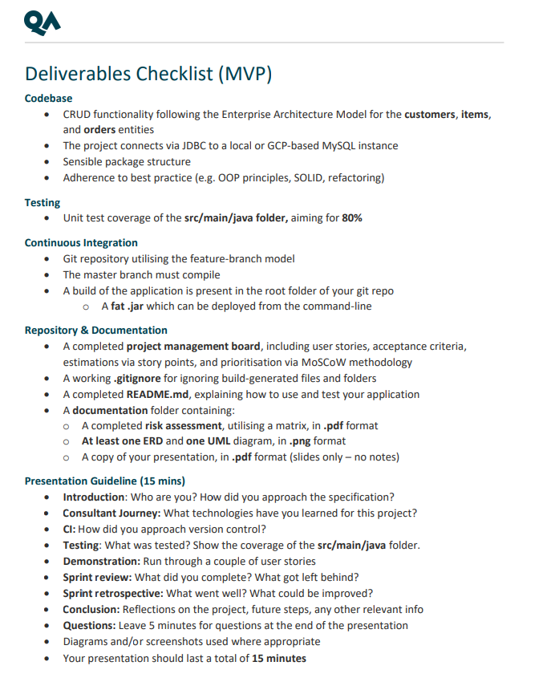
Intro
I approached the project by looking:
Reviewing the specifications of the deliverables.
Planned out what would be required of each task.
I reviewed the base of the code.
I planned what to begin coding first and how to structure the orders & orders_items relationship.

Slide 4
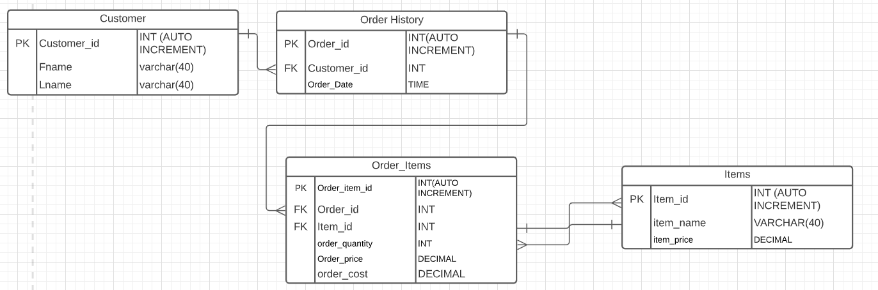
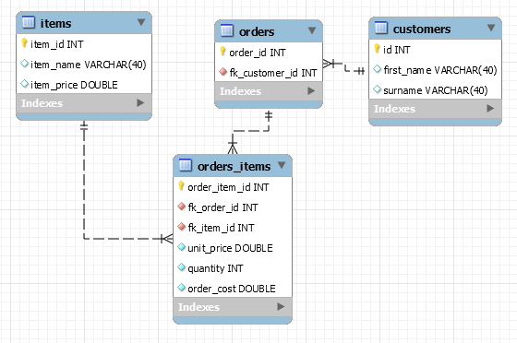
Intro - Database Schema
Initial Schema Concept
The final Schema

Slide 5
Consultant Journey
Java – New Language Learned
JUnit & Mockito – New Testing Framework
Eclipse – New Technology
Maven – New Technology
MySQL – Previous Understanding
Git – Previous Experience
GitHub – Previous Experience

Slide 6
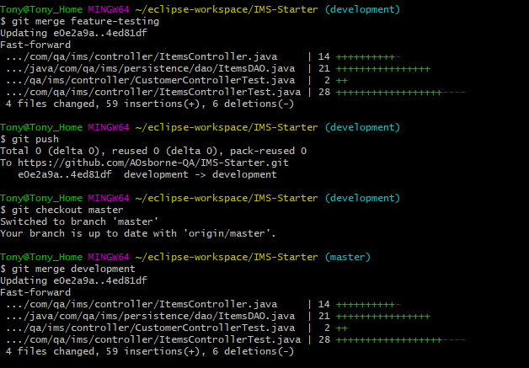
Version Control
Version Control System – Git
Control Approach – Feature-Branch model

Slide 7
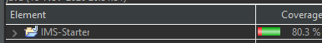
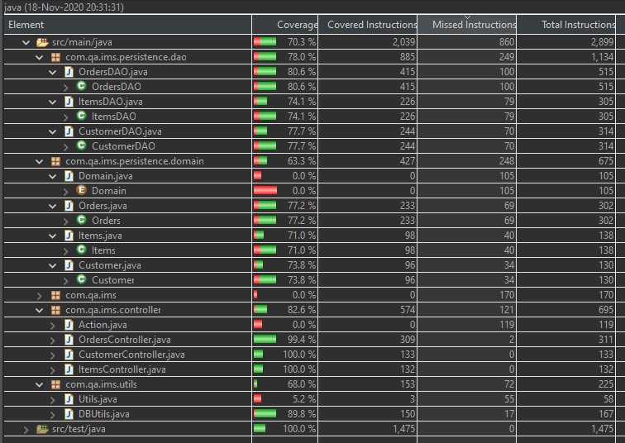
Testing
Testing for the project was done using JUnit & Mockito.
JUnit tests were made to test the Data Access Objects (DAO).
Mockito was used for integration tests in order to test the controllers.
80.30% Test coverage Achieved

Slide 8
DEMO of IMS

Slide 9
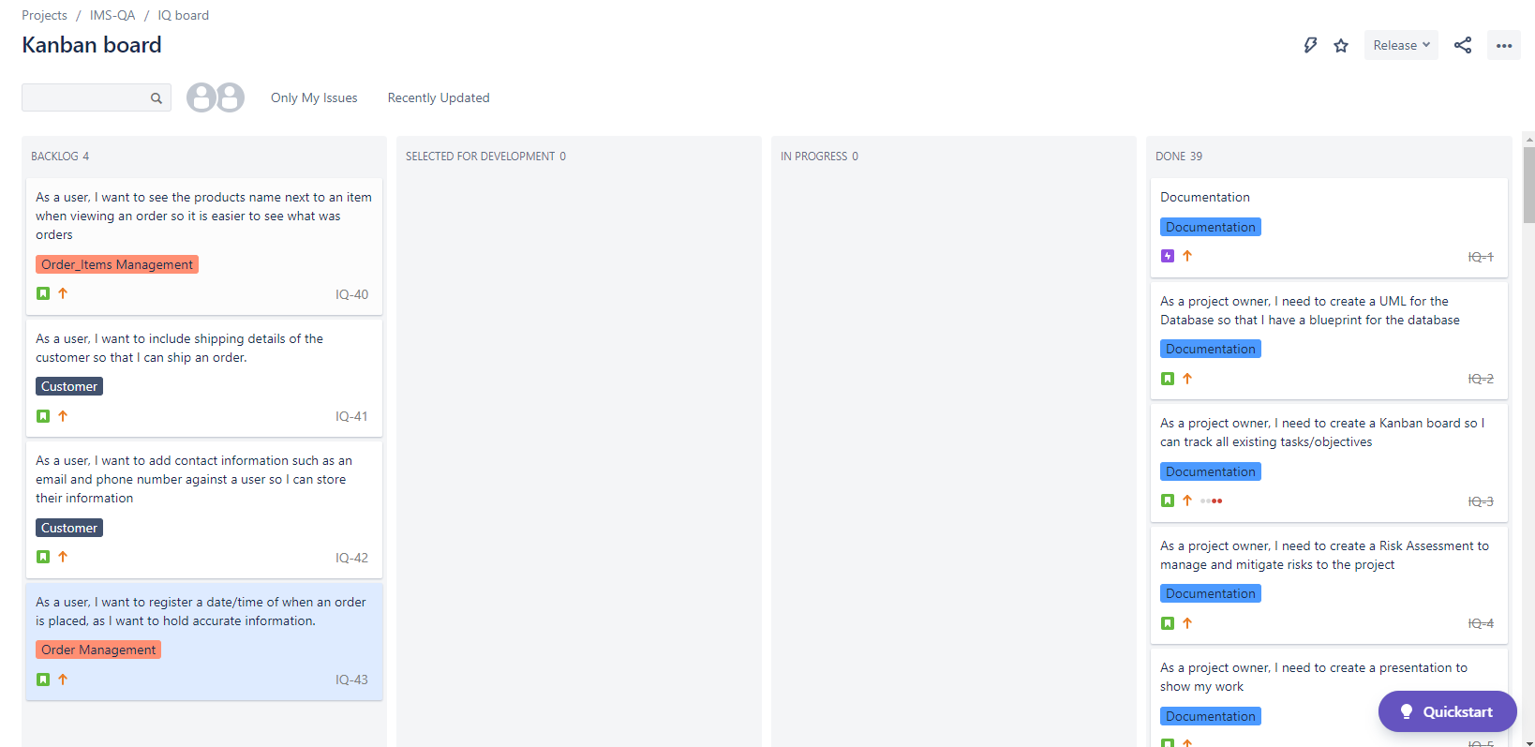
Sprint Review
What did I complete?
All user stories for MVP were completed
I had some items on my wish list that I was not able to complete due to lack of time.
Further information for customers – address, email, contact number
Displaying the name of the product in an order when it is read.
Displaying & recording the date/time of when an order is placed

Slide 10
Sprint Retrospective
What went well?
User stories were followed in a logical way.
Prioritising smaller tasks and building up to the more complex functionalities.
The interface has full CRUD functionality and works as intended.
What could be improved?
Hosting the application and database through AWS/GCP/Azure.
Hiding the password for connecting to the database.
How the information is present to a user when they “Read All”
Further testing to ensure all Exceptions work.

Slide 11
Conclusion
Really enjoyed the project and learned a lot throughout it.
I gained experience in Java and testing frameworks
Gave experience in project planning & execution
How to interact with MySQL using Java.

Slide 12
Thank you For listening Questions

